Slide 1
RHEUMATIC FEVER
Dr. Haripriya Jayakumar
Senior resident

Slide 2
Introduction
History
Epidemiology
Etiology
Immunopathogenesis
Pathology
Clinical features
Diagnosis
Treatment
Prevention

Slide 3
Introduction
Rheumatic fever is –
inflammatory systemic disease
triggered by Group A Streptococcus
(non-suppurative complication)
genetically predisposed individuals
Leading cause of acquired heart disease in children and young adult worldwide

Slide 4
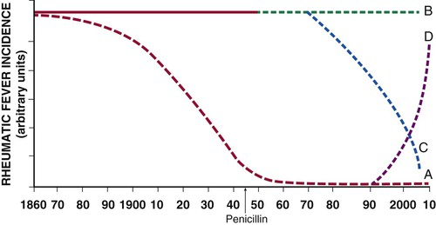
Epidemiology - Disease trend
Notes:
Four pattern of incidence of rheumatic fever over past 150 years.
Curve A – preantibiotic fall in the incidence of RF, typical of industrialised countries.
Curve B – persistent high incidence in regions with no comprehensive programme for prevention – Africa, middle east, eastern europe, south america, indeginous communities of australia
Curve C – post antibiotic fall – countries with programmes for primary and secondary prevention – cuba, costa rica, martinique and guadeloupe
Curve D- fall and rise in incidence in countries like the Soviet Republics of central Asia

Slide 5
WORLD WIDE INCIDENCE 1970-1990
Seckeler, Hoke: The worldwide epidemiology of acute rheumatic fever and rheumatic heart disease; Clinical Epidemiology, 2011

Slide 6
WORLDWIDE INCIDENCE 1990-2011

Slide 7
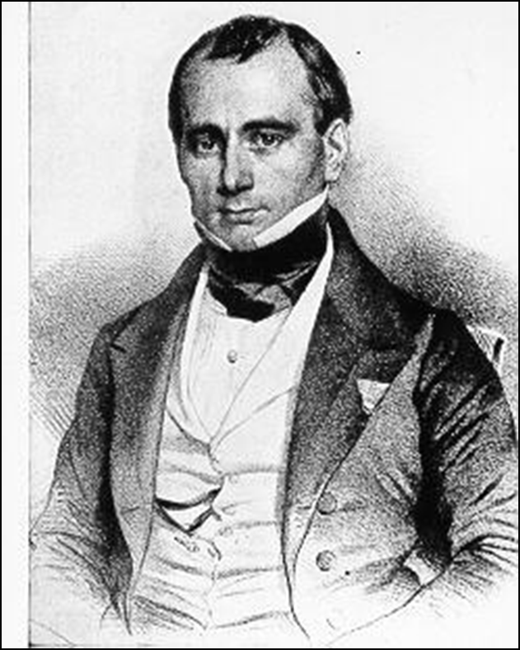
Names to be remembered..
Rheumatic fever described since the 17th century
Sydenham – related chorea with arthitis 1600s
Charles Wells (1812) – Association of rheumatism with carditis and subcutaneous nodules
Jean –Baptiste Bouillaud (1836) – 1st publication on rheumatic fever (‘Father of rheumatic heart disease’)
Walter B Cheadle (1889)– 1st classic description of rheumatic fever.

Slide 8
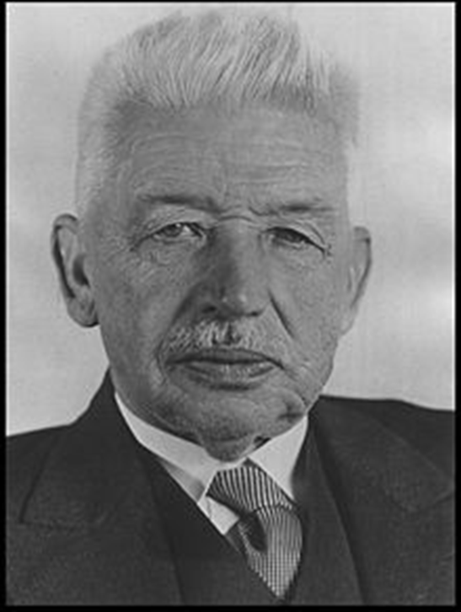
Ludwig Aschoff(1904) - 1st description of pathology of rheumatic carditis.
Alvin F Coburn (1931) – 1st proved causal relationship between Beta hemolytic Strep and ARF
Rebecca Lancefield (1933) – Serogrouping of Streptococci
T Duckett Jones (1944) – 1st diagnostic criteria for RF. He presented his paper on the diagnosis of rheumatic fever in Chicago (AMA meeting)

Slide 9
The epidemiological triad
Agent
Host
Environment

Slide 10
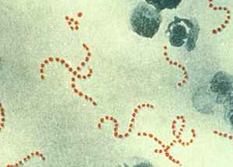
The agent - Group A beta hemolytic streptococci
Gram positive cocci
chain / pair
Non sporing, non motile
Facultative anerobes
Encapsulated

Slide 11
Lancefield serological classification
On the basis of the C carbohydrate antigen on the cell wall
Streptococci classified into many groups from A-K & H-V

Slide 12
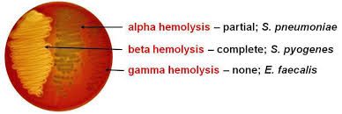
Classification based on hemolysis in sheep blood agar
Notes:
hemolysis
Partial hemolysis
Green discoloration around the colonies
e.g. non-groupable streptococci (S. pneumoniae & S. viridans)
β-hemolysis
Complete hemolysis
Clear zone of hemolysis around the colonies
e.g. Group A & B (S. pyogenes & S. agalactiae)
γ-hemolysis
No lysis
e.g. Group D (Enterococcus spp)

Slide 13
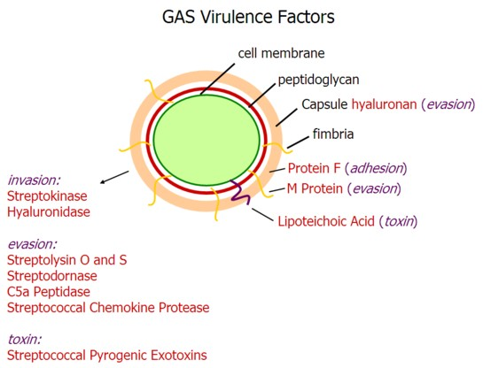

Slide 14
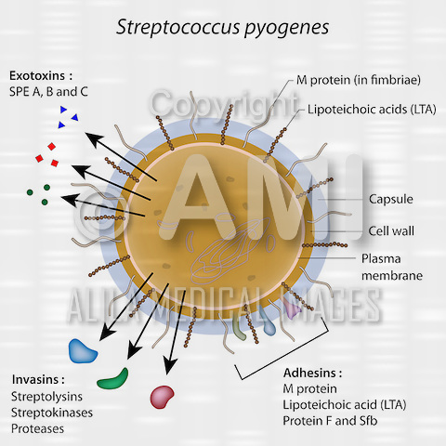

Slide 15
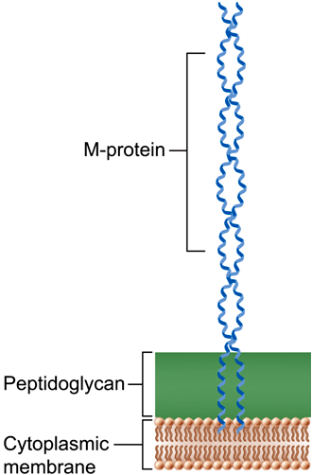
The M protein:
major surface antigen
epitopes which cross react with myocardium, synovia, skin and brain
Alpha helical coiled-coil fibrillar protein– significant homology in structure & amino acid sequences to tropomyosin, myosin, keratin, vimentin & laminin.

Slide 16
Based on the conserved C repeat regions Class I & Class II GAS strains are named.
It is the Class I M-type of which belongs the strains 1,3,5,6,14,18,19 and 24 ---that have been associated with RF

Slide 17
GAS pharyngitis
Age group : 5-15 years
In epidemics, 3 % of untreated cases – developed RF
In endemic areas, 0.3% of untreated cases developed
Infection may be asymptomatic in 30-50% of cases of RF (approx one-third)

Slide 18
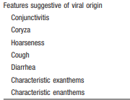

Slide 19
The environment
Overcrowding
Poverty
Poor nutrition
Poor hygiene
Poor access to health care
Rapid spread
Lack of primary prevention
Lack of secondary prevention

Slide 20
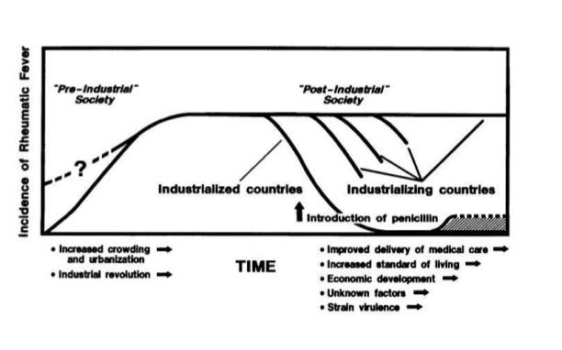
Change in environment factors

Slide 21
The host
Genetic susceptibility
Exact pattern of inheritence not identified
The evidence:
Familial aggregation of cases – first described by Cheadle
Children whose parents had RF had 2.93 times increased risk
Studies in monozygotc twins – 6 times than in dizygotic twins
The heritability of RF is 60%

Slide 22
HLA-II (Chr 6) is the gene most associated with RF and development of RHD
HLA-DR7 mostly associated with progressive valvular lesions in RHD
HLA-DR53, HLA-DQA, HLA-DR4, HLA-DR9
(determines antigen presentation to T-cell receptors)
TNF alpha and TGF β
Non HLA B cell antigen D8/17 is associated with increased susceptibility

Slide 23
Components of Adaptive Immune Response
CTLA 4 in addition to HLA II
Components of Innate Immune Response:
Ficolin 2
Mannose binding Lectin 2
Receptor for Fc Fragments of IgG
Toll Like Receptor 2
Cytokine Genes
TNF α and TGF β, IL 1 receptor A, IL – 10
B cell alloantigens
Notes:
Though significant association has been found, study results either conflict with each other or have not been replicated
Not possible to predict individuals at risk for developemnt of RF following an episode of untreated strep pharyngitis

Slide 24
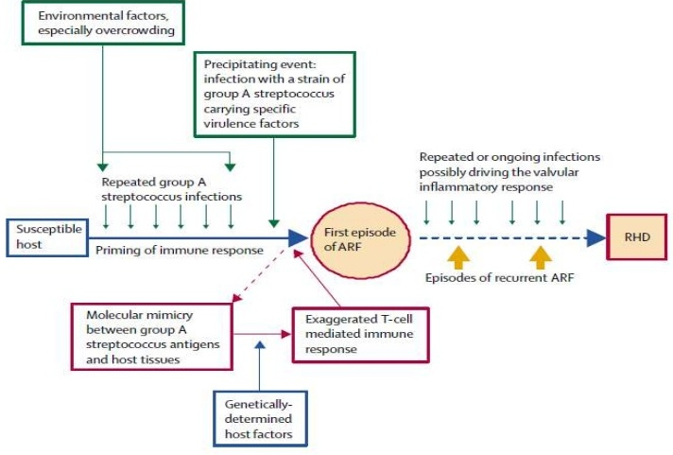

Slide 25
Immunopathogenesis
Molecular mimicry:
B-cell mediated
T- cell mediated
Superantigens
alternate hypothesis

Slide 26
Molecular mimicry
Sharing of epitopes between host tissue and bacterial antigens
Kaplan et al(1965) was the first to postulate molecular mimicry as the cause of RF by demonstrating Igs and complement bound to cardiac tissue (in the absence of bacteria) following streptococcal infection.
Cunningham reviewed the hypothesis of molecular mimicry

Slide 27
Antibody (B cell) mediated:
Recognition of aminoacid sequences
2) Recognition of homologous non-identical amino acid sequences
3) Recognition of epitopes on different molecules
Cell mediated (T cell) :
By antigen presentation to TCR
2) Epitope spreading (i.e T cells recognize epitopes in other proteins with equal or more priority than the original bacterial epitope)

Slide 28
Antibody mediated injury
Antigens implicated, not definitely proved:
- ?M protein
- group A carbohydrate (N-acetyl glucosamine)
Targets of antibody mediated injury:
- myosin
- vimentin
- tropomyosin
- keratin
- laminin

Slide 29
GAS antigen | Target structure
Group A carbohydrate GlcNac | Laminin, laminar basement membrane and cardiac myosin
T cell : streptococcal M protein | Cardiac myosin
Sydenham Chorea: GlcNac | Dopamine receptors and tubulin
The theme of molecular mimcry – recognition of intracellular biomarker antigens like cardiac myosin and tubulin, while targetting extracellular membrane antigens- laminin or dopamine

Slide 30
Immunopathogenesis – a two hit hypothesis
1. Auto-Abs home in, damage and inflame the valve endothelium (? Laminin)
Complement mediated injury takes over
Upregulation of VCAM-1 occurs on endothelial surface
2. T cell mediated extensive injury and tissue infiltration via VCAM-1
(Epitope spreading – vimentin, myosin, ? Ags on VICs)
CD4+ TH1 mediated granulomatous inflammation
IFN gamma and TNF alpha mediated fibrosis, Low IL4 production
Neovascularization, persistence of inflammation & scarring

Slide 31
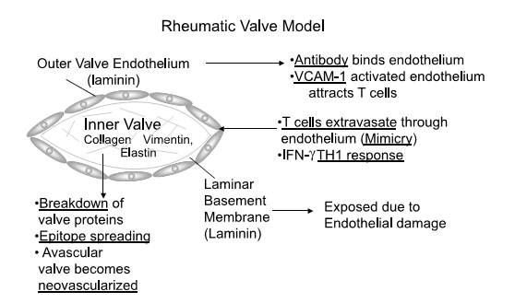

Slide 32
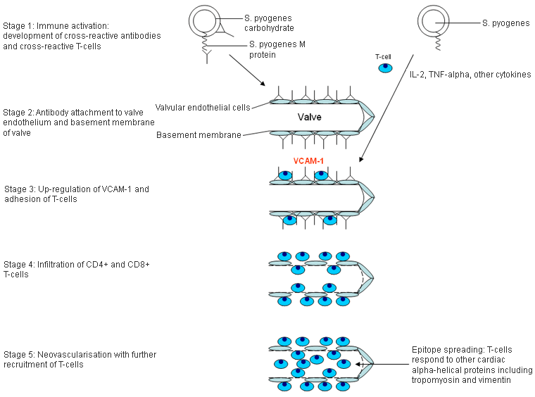

Slide 33
Superantigens
They are glycoproteins found on bacterial cell wall that promote the binding of MHC Class II with TCRs --- thus inciting T-cell activation and release of cytotoxins.
Streptococcal pyrogen exotoxin– a possible culprit - May explain the systemic inflammatory changes

Slide 34
Alternate hypothesis
Over the past 5 years an M protein N-terminal domain has been noted to bind to the CB3 region of Collagen type IV.
an antibody and immune response against collagen and surrounding ground tissue.
These Abs do not bind to the M protein - thus refuting the “Molecular Mimicry” theory
similar to the collagen related inflammation seen in Alports syndrome & Goodpastures syndrome.
Rajendra Tandon et al. Revisiting the pathogenesis of rheumatic fever and carditis. Nat Rev Cardio, Mar 2013.

Slide 35
Pathology
Predominantly endothlelial disease with inflammation and damage to the collagen and connective tissue
Generalised vasculitis

Slide 36
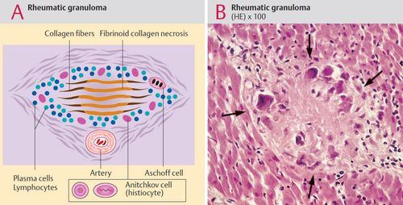
Carditis
Hallmark – Aschoff bodies
Found in all layers- endocardium, myocardium and pericardium

Slide 37
Aschoff body
Around 1-2mm
Lymphocytes, macrophages, Anitschkow cells and giant cells (Aschoff cells)
No myocytes
Perivascular
Goes through various stages
Fibrinoid/Exudative stage (2-3 weeks)
Granuloma/Proliferative stage(1-6months)
Perivascular scarring
Anitschkow cells- caterpillar nucleus – giant macrophages
Aschoff cells – coalition of Anitschkow cells

Slide 38
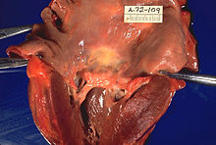
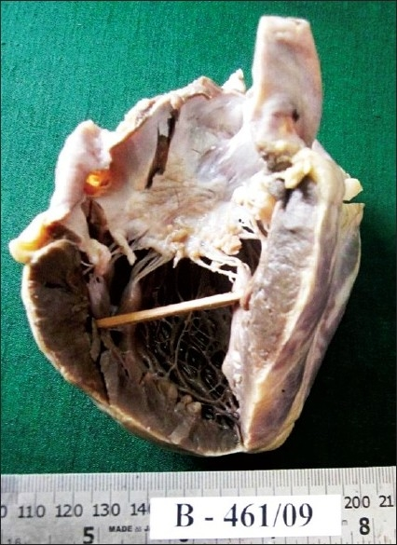
Mc Callum’s patch
McCallum’s patch: Gross finding of endocardial thickening in the posterior wall of LA due to inflammation as well as ‘jet’-trauma

Slide 39
Rheumatic verrucae
Notes:
progressive inflammation causing necrotic collagen to project outwards from the valve, On which platelet thrombi deposit.
- Rheumatic verrucae occur on the atrial surface at sites of valve closure
and on the chordae.
-The valves become edematous thickened and vascularised.

Slide 40
CNS - CHOREA
Disseminated meningoencephalitis affecting basal ganglia, caudate nucleus, putamen, internal capsule and cerebellum
Obliterative endarteritis of cerebral and meningeal small vessels
Perivascular inflammation and petechial haemorrhage
Grossly normal brain tissue

Slide 41
ARTHRITIS
Endothelial inflammation of the synovia
Fibrinoid granuloma, edema and diffuse inflammation.
Lasts for around 2-3 weeks
No permanent damage

Slide 42
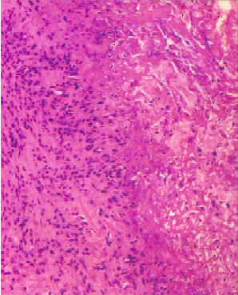
SUBCUTANEOUS NODULE
Central zone of necrosis surrounded by surrounded by histiocytes and fibroblasts along with perivascular inflammation
Induration occurs principally due to perivascular oozing of plasma and cells into connective tissue.
Do not exhibit the pallisading pattern of RA

Slide 43
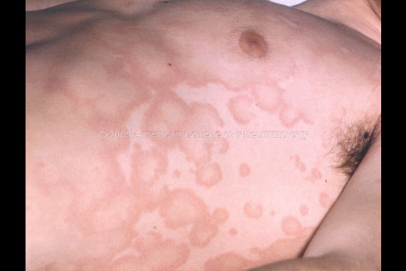
ERYTHEMA MARGINATUM
Dermal inflammation with minimal keratinocyte necrosis

Slide 44
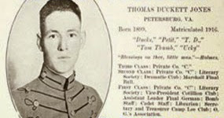
DIAGNOSIS

Slide 45
Original Duckett Jones criteria, 1944
MAJOR MANIFESTATIONS | MINOR MANIFESTATION
Carditis Arthralgia Chorea Subcutaneous Nodules 5. H/O Of Previous Definitive RF Or RHD | 1.Fever 2.Abdominal Pain 3.Precordial Pain 4.Rashes( Erythema Marginatum) 5.Epistaxis 6.Pulmonary Findings 7.Lab Findings A.ECG B.Microcytic Anaemia C.Elevated TLC D.Raised ESR

Slide 46
Modified Jones criteria, 1956
MAJOR MANIFESTATION | MINOR MANIFESTATION
1.Carditis 2.Polyarthritis 3. Chorea 4.Subcutaneous Nodules 5.Erythema Marginatum | 1.Fever 2.Arthralgia 3.Prolonged Pr Interval 4.Increased ESR,CRP Or Leukocytosis 5.Previous H/O Of Rf Or Rhd 6.Evidence Of Preceeding Beta Hemolytic Streptococcal Infection

Slide 47
Revised Jones criteria, 1965
MAJOR MANIFESTATION | MINOR MANIFESTATION
1.CARDITIS 2.POLYARTHRITIS 3. CHOREA 4.SUBCUTANEOUS NODULES 5.ERYTHEMA MARGINATUM | 1.FEVER 2.ARTHRALGIA 3.PROLONGED PR INTERVAL 4.INCREASED ESR,CRP OR LEUKOCYTOSIS 5.PREVIOUS H/O OF RF OR RHD
Supporting Evidence Of :
Preceeding Streptococcal Infection
H/O Recent Scarlet Fever;
Positive Throat C/S For Group A Streptococcus;
Increased ASO Titre

Slide 48
Jones criteria update, 1992
MAJOR MANIFESTATION | MINOR MANIFESTATION
1.CARDITIS 2.POLYARTHRITIS 3. CHOREA 4.SUBCUTANEOUS NODULES 5.ERYTHEMA MARGINATUM | 1.FEVER 2.ARTHRALGIA 3.PROLONGED PR INTERVAL 4.LAB FINDINGS ELEVATED ACUTE PHASE REACTANTS,INCREASED ESR,CRP
Supporting Evidence Of Preceeding Streptococcal Infection:
Positive Throat C/S For Group A Streptococcus
Rapid Antigen Test
Elevated or Rising Streptococcal Antibody Titre

Slide 49
Evolution of Jones criteria

Slide 50
Concerns with Jones criteria
Did not cover – recurrence of RF
indolent carditis
chorea
Underdiagnosis in endemic area

Slide 51
WHO 2002-2003

Slide 53
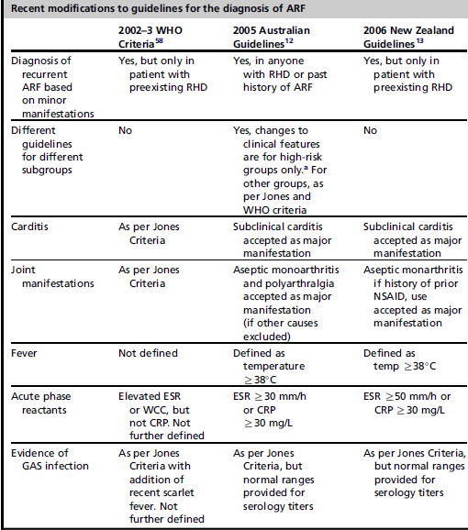

Slide 54
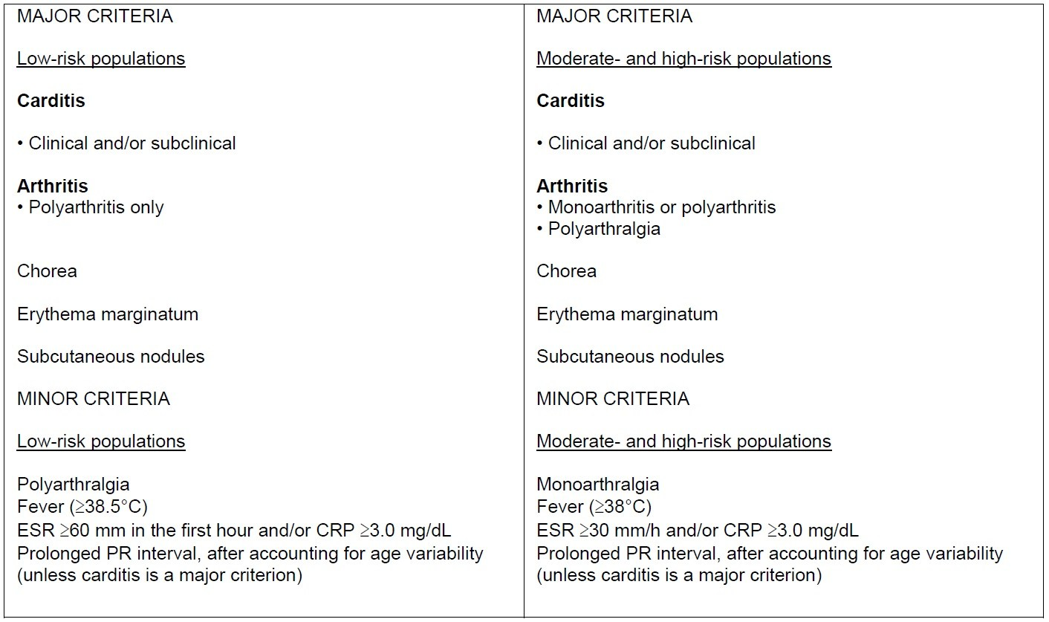
2015 AHA revision of Jones criteria
Low risk: ARF incidence <2/100,000 school aged children (age 5-14 years)
or all age prevalence of RHD <1 per 1000 population per year

Slide 55
For all patient populations with evidence of preceding GAS infection
Diagnosis: INITIAL ARF: 2 Major manifestations or
1 major + 2 minor manifestations
Diagnosis: RECURRENT ARF: 2 Major or
1 major + 2 minor or
3 minor

Slide 56
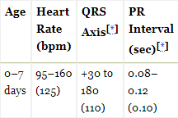
PR interval
Age wise upper limit in children
0.16 if <12 yr
0.18 if >12 yr
Used when carditis is not a major criterion
Park MK: Pediatric Cardiology for Practitioners, 4th ed. St Louis, Mosby, 2002, and Davignon A et al: Normal ECG standards for infants and children. Pediatr Cardiol 1979; 1:123–131.

Slide 57
clinical features

Slide 58
CLINICAL FEATURES
Precipitating event : Streptococcal pharyngitis
Latent period : 2 to 3 weeks
Asymptomatic GAS infection:
1/3rd of patients with ARF
58% of patients in outbreak
Drawback of using primary prevention with antibiotics alone
Need for vaccination

Slide 59
Major criteria
Arthritis
Carditis
Erythema marginatum
Sydenham’s chorea
Subcutaneous
nodules

Slide 60
Carditis
Most serious manifestation
Early manifestation- 2 weeks of onset
Incidence: 40-91%
Age | Incidence with 1st attack
<3 years | 90-92%
3-6 years | 50%
14-17 years | 32%
adults | 15%
Notes:
Incidence varies with the population selected and whether echo was used in the diagnosis

Slide 61
Pancarditis
Myocarditis , in the absence of valvulitis is unlikely to be rheumatic in origin
ENDOCARDIAL
MYOCARDIAL
ECG change
PERICARDIAL
VALVULIITS
Presence of organic murmur
Cardiomegaly
Congestive heart failure
Pericaridal friction rub or effusion

Slide 62
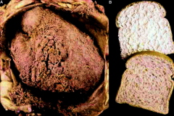
Pericarditis
6-15% of those who have rheumatic carditis
transient pericardial rub
usually result in mild effusion
Designate severe carditis
Bread and butter pericarditis
Notes:
Pericardial effusion rarely result in tamponade or constrictive pericarditis.
The pericarditis of acute rheumatic fever is not a true infective pericarditis.It is more of inflammation .It is primarily T cell mediated reaction . Neutrophils rarely take part in this inflammation and hence no significant exudation . Hence , there is less sticky and adhesive molecules inside the pericardial space .The most inflamed layer is epicardium which a nothing but visceral pericardium .This layer lacks the tensile strength to constrict the underlying myocardium

Slide 63
Myocarditis
Clinical evidence:
soft S1
cardiomegaly
S3 gallop
conduction abnormalities
congestive heart failure

Slide 64
Does rheumatic myocarditis exist??
(i) absence of increase in markers of myocardial damage -CK-MB, trop I , T
(ii) normal left ventricular systolic function and myocardial contractility by ECHO
(iii) radionuclide studies using technetium pyrophosphate scanning and indium^{III} labelled anticardiac myocin Fab (FAB) do not indicate presence of myocardial damage
(iv) myocardial biopsy studies have not been able to identify the presence of myocarditis
Notes:
immunopathology of Ashoff nodule (AN), the diagnostic marker of rheumatic pathology, being derived from mesenchymal cells, complete absence of cells of myocardial origin in AN and absence of actin, myosin and desmin (of myocardial origin) in the AN indicating that AN is not of myocardial origin

Slide 65
(v) normalization of heart size and disappearance of congestive failure following MVR/AVR in patients deteriorating in spite of aggressive medical management
(vi)histopathology of the left ventricular myocardium showing absence of myocardial or inter-myocardial connective tissue damage
(vii) immunopathology of Ashoff nodule (AN), the diagnostic marker of rheumatic pathology, being derived from mesenchymal cells, complete absence of cells of myocardial origin in AN and absence of actin, myosin and desmin (of myocardial origin) in the AN indicating that AN is not of myocardial origin
Hence, CCF in acute RF may be due to an acute volume overload from MR/AR but not due to myocarditis per se.

Slide 66
Endocarditis
Valvulitis – most important clinical feature - future morbidity
valvular regurgitation and not stenosis
Valve involvement:
Stenotic lesion: recurrence and repeated inflammation of valve
Valve | Percentage
Mitral | 70-75%
Aortic | 20-25%
Tricuspid | 30-35% (at autopsy)
Pulmonary | Rare

Slide 67
Mitral valve involvement
Most common valvular involvement
Pathogenesis of MR
Valvulitis
Mitral annular dilatation
Leaflet prolapse with or without chordal elongation
Chordal rupture
Valvulitis
verrucous formation
nodules along the line of closure of valves

Slide 68
Mild to moderate MR
mild or no annular dilatation
no mitral valve prolapse
left ventricular dilatation
Severe MR
annular dilatation
chordal elongation
anterior mitral leaflet prolapse
Associated with worst prognosis - fatal HF
Incidence of chronic RHD 90%.
Linear relationship between the severity of MR during the first episode of RF and subsequent RHD.

Slide 69
Clinically
Soft blowing PSM of MR at apex
Carey Coomb’s : low pitched MDM at apex
no presystolic accentuation
disappears on follow up
Due to increased flow through diseased mitral valve
92-95% of patients with carditis
70-75% of patients, only valve affected

Slide 70
Aortic valve involvement
High-pitched soft decrescento murmur of AR.
AR in the absence of MR is uncommon
20-25% of patients with carditis
Isolated finding in 5-8%.

Slide 71
Clinical recognition of recurrence of rheumatic carditis
Valvulitis
Change in murmur
New onset murmur
Myocarditis
Evanescent murmurs
Worsening cardiomegaly
Worsening CHF
Pericarditis
Pericardial rubs
Pericardial effusion

Slide 72
Arthritis
One of the earliest manifestation
70-75% of patients
Polyarthritis – migratory
Maximum severity in 12-24 hours
Persists for 2-6 days at each site
Joints involved:
large joints of the lower extremities (ie, knees, ankles)
large joints in the lower or upper extremities (ie, elbows, wrists
Pain
out of proportion to other inflammatory findings
Dramatic response to salicylates
Notes:
. Involvement of the spine, small joints of the hands and feet, or hips is uncommon.
Rheumatic joints are generally hot, red, swollen, and exquisitely tender; even the friction of bedclothes is uncomfortable

Slide 73
More common and severe in teenagers and young adults than in younger children
Without treatment – last for 4 weeks maximum, no residual deformity
Synovial fluid in ARF usually has 10,000-100,000 WBC/mm3
Exudative with normal glucose & neutrophil predominance
protein concentration is approximately 4g/dL
gram stain negative
a good mucin clot is present
Inverse relationship b/w the severity of arthritis & cardiac involvement
Notes:
(rarely more than 4 wk, but has been reported to persist 44 d)
. Monoarticular arthritis is unusual unless antiinflammatory therapy is initiated prematurely, aborting the progression of the migratory polyarthritis. If a child with fever and arthritis is suspected of having acute rheumatic fever, it frequently is useful to withhold salicylates and observe for migratory progression. A dramatic response to even small doses of salicylates is another characteristic feature of the arthritis, and the absence of such a response should suggest an alternative diagnosis. for example, found severe cardiac involvement in 10% of those with
arthritis, 33% of those with arthralgia, and 50% of those with no joint
symptoms

Slide 74
MONOARTHITIS
If treated with NSAID early in the course, before other signs and symptoms
NSAIDs – OTC
series including 555 Aboriginal patients in Australia, aseptic monoarticular arthritis was also described in 17 percent of cases

Slide 75
POST STREPTOCOCCAL REACTIVE ARTHRITIS
Differentiating features:
Relatively shorter latent period ( 7 to 10) days
May be persistent or relapsing
Slower response to aspirin
Not associated with other major manifestations
Secondary prophylaxis advised for five year

Slide 76
JACCOUD ARTHRITIS
Chronic post rheumatic arthropathy
Occur after repeated attacks of RF
Recurrent inflammation of the fibrous articular capsule
Clinically, non tender, no signs of inflammation
No true erosion on X-ray, RA factor negative
Notes:
Rare manifestation
Characterised by deformity of fingers and toes
Ulnar deviation of the fingers, esp 4th and 5th , flexion of mcp joint, hyperextension of PIP( swan neck deformity)

Slide 77
Subcutaneous nodules
Incidence <1-21%
Round, firm, nontender, and mobile
range from a few millimeters to 1-2 cm
Number vary 1- dozen, mean 3-4
Occur in crops over bony prominences and extensor tendon
scalp, especially the occiput, and the spinous processes of the vertebrae, elbows, wrists, knees, ankles and Achilles tendon
Lasts for 1-2 weeks, rarely to a month
Associated with carditis
usually appearing several weeks after the onset of cardiac findings

Slide 78
Erythema marginatum
Occurs in 15% of patients
Evanescent serpigenous erythematous macular lesions with central clearance
Site: trunk, proximal extremities, rarely distal.
never on face.
“smoke rings”
Accentuated by warming the skin
May blanch on pressure
Difficult to see in dark-skinned people
Notes:
The lesions of erythema marginatum appear first as a bright pink
macule or papule that spreads outward in a circular or seripiginous
pattern.
Individual lesions may come and go in minutes to
hours, at times changing shape before the observer’s eye or coalescing
with adjacent lesions to form varying patterns
however, persist or recur for months or even
years, continuing after other manifestations of the disease have subsided,
and it is not influenced by anti-inflammatory therapy. This
cutaneous phenomenon is associated with carditis but, unlike subcutaneous
nodules, not necessarily with severe carditis. Nodules and
erythema marginatum tend to occur together

Slide 79
Early manifestation – may recur
Not influenced by anti-inflammatory drugs
Associated with carditis, but not necessarily with severe carditis

Slide 80
Sydenham chorea
First described by Sir Thomas Sydenham and Guillaime de Bailou in the late seventeenth century
St. Vitus dance- patron saint of dancers
During feast of Saint Vitus manic dancing occurs in front of his statue – resemblance to the jerky erratic movement in Sydenham’s chorea
Notes:
Seen almost never in postpubertal males.

Slide 81
Seen in females, rare after >20 years
Prevalence : 5–36%
Description:
quasipurposive involuntary movement which subsides with sleep or sedation
Emotional lability, incordination, muscular weakness
fretful, irritable, inattentive to schoolwork
clumsiness and a tendency to drop objects
Change in handwriting

Slide 82
Signs:
‘bag of worms’ tongue
pronator sign
milkmaid sign
dish or spoon sign
No sensory or pyramidal tract signs

Slide 83
Latent period – 1- 8 months after a GAS infection
Recurrence- uncommon; sometime with pregnancy / OCP usage
Usually fully recover in 6 weeks, rarely upto 6 months
23% pure rheumatic chorea developed MS in 20 yr follow up & 27% in 30 yr period
Inflammatory markers & ASO titres may be normal ( long latent period)

Slide 84
PANDAS
Pediatric autoimmune neuropsychiatric disorders associated with streptococcal infections
Autoimmune responses that cross-react with brain tissue in response to a GAS infection
Obsessive-compulsive & tic disorders
No need of secondary prophylaxis (Class III, LOE B

Slide 85
Five criteria have been used to define the PANDAS subgroup
• The presence of a Tic disorder and/or OCD
• Pre-pubertal age of onset (usually between 3 and 12 years of age)
• Abrupt symptom onset and/or episodic course of symptom severity
• Temporal association between symptom exacerbations and streptococcal infection (approx 7-14 days)
• Presence of neurologic abnormalities

Slide 86
* High risk population*
PSRA
It is recommended that the diagnosis of post-streptococcal reactive arthritis should rarely, if ever, be made in high-risk populations and with caution in low-risk populations (Grade C).
Patients so diagnosed should receive secondary prophylaxis for at least 5 years (Grade D)
Echocardiography (see above) should be used to confirm the absence of valvular damage in all of these cases before discontinuing secondary prophylaxis (Grade D)

Slide 87
* High risk population*
PANDAS
In New Zealand populations with a high prevalence of ARF, clinicians should rarely (if ever) make a diagnosis of PANDAS, and should rather err on the side of over-diagnosis of ARF and secondary prophylaxis (Grade D).
Such cases should be carefully followed up to ensure that they do not develop carditis in the long term

Slide 88
Differential diagnosis

Slide 89
Minor manifestation
Minor manifestation

Slide 90
Fever
Temperature >38 C in high risk popln
>38.5 C in low risk popln
diurnal variations are seen
No specific pattern of fever
Children with mild carditis and chorea may be afebrile
Arthralgia
constitutes pain in one or more joints without other inflammatory signs
Epistaxis seen in 4% of cases
Abdominal pain
5% of cases - occurs before the appearance of major manifestation
Pain usually epigastric or periumblical & may mimic appendicitis

Slide 91
Laboratory evidence
Elevated inflammatory markers
INFLAMMATORY MARKER | LOW RISK POPLN | HIGH RISK POPLN
ESR | > 60 mm/1st hr | >30 mm/1st hr
CRP | >3 mg/dL | >3 mg/dL

Slide 92
ECG findings
1) Persistent sinus tachycardia & an elevated sleeping pulse rate are signs of carditis
2)Sinus bradycardia
3) PR prolongation
Seen in 20- 30% of cases
Proposed theory – due to vagal overactivity, myocardial inflmn
No correlation with carditis and future development of RHD
4) High grade AV block ,CHB
5) pericarditis
6) QT prolongation

Slide 93
Evidence of GAS
Throat culture
The gold standard for diagnosing streptococcal pharyngitis.
Throat swabs should be inoculated on culture media within 5 hours.
Limitations:
It does not differentiate between a carrier state and active infection.
1/3 of patients with rheumatic fever give no history of a preceeding pharyngeal infection.
delay in obtaining results of throat cultures

Slide 94
RAPID ANTIGEN DETECTION from throat swab
latex agglutination or immunoassay
Reliable, cost effective
Specificity 95%
Sensitivity 33%
Equivalent to positive throat culture

Slide 95
STREPTOCOCCAL ANTIBODY TESTING
Antistreptolysin O (ASO)
Anti DNAase B
Anti hyaluronidase (AH)
Streptozyme(SZ)

Slide 96
Antistreptolysin antibody
Described by Todd in 1932
Most widely used
Two fold rise in paired serum sample taken 2-4 weeks apart more specific than a single sample
Appears :7 to 10 days after the infection
peak detection :2 & 3 weeks after the onset of RF
maintained for 2-3 months before declining
ASO Titre
> 240 Todd units in adults
> 320 Todd units in children > 5 yrs

Slide 97
Anti DNAse B
begin to rise 1 to 2 weeks and peak 6 to 8 weeks after infection
Anti DNAse 1:60 in preschool
1:480 in school age
1:340 in adult ( NORMAL TITRE)
Single antibody test - ( only ASO) - 80-85%
Multiple antibody test- (ASO +ANTIDNase B) - 95-100%

Slide 99
B Cell marker
- Rapid detection test for D8/17
- positive in 90% of cases with rheumatic fever

Slide 100
Echocardiography in ARF
The significance:
Among various manifestation, carditis can cause death in acute stage or lead to long term morbidity
Echo is the only modality by which carditis can be assessed reliably
Notes:
Only of 59.4% of clinically diagnosed carditis by well qualified pediatricians had ECHO evidence of carditis.
On the other hand in the patients with polyarthralgia (70%) which is a minor criterion, ECHO evidence of carditis / valvulitis was seen in 46.9% of cases

Slide 101
Subclinical carditis
exclusively to the circumstance in which classic auscultatory findings of valvular dysfunction either are not present or are not recognized by the diagnosing clinician but echocardiography/Doppler studies reveal mitral or aortic valvulitis
Metaanalysis on subclinical arthritis :
-prevalence of subclinical carditis was 16.8 %
-persistence or worsening of carditis in patients with subclinical carditis was 44.7%

Slide 102
Recommenmdations
1. Echocardiography with Doppler should be performed in all cases of confirmed and suspected ARF (Class I; Level of Evidence B).
2. It is reasonable to consider performing serial echocardiography/Doppler studies in any patient with diagnosed or suspected ARF even if documented carditis is not present on diagnosis (Class IIa; Level of Evidence C).
3. Echocardiography/Doppler testing should be performed (strictly fulfilling the findings noted in Tables 2 and 3) to assess whether carditis is present in the absence of auscultatory findings, particularly in moderate- to high-risk populations and when ARF is considered likely (Class I; Level of Evidence B).
4. Echocardiography/Doppler findings not consistent with carditis should exclude that diagnosis in patients with a heart murmur otherwise thought to indicate rheumatic carditis (Class I; Level of Evidence B).

Slide 103
Doppler findings in rheumatic valvulitis
MITRAL REGURGITATION
Seen in 2 views
In at least 1 view jet length >2cm
Peak velocity > 3m/sec
Pan-systolic jet in at least one envelope
AORTIC REGURGITATION
Seen in 2 views
In at least one view jet length >1cm*
Peak velocity >3m/sec
Pan-diastolic jet in at least one envelope

Slide 104
Morphological findings in echocardiogram in ARF
Acute mitral valve
Annular dilation
Chordal elongation
Chordal rupture resulting in flail leaflet with severe mitral regurgitation
Anterior (or less commonly posterior) leaflet tip prolapse
Beading/nodularity of leaflet tips
Aortic valve changes
Aortic valve changes in either acute or chronic carditis
Irregular or focal leaflet thickening
Coaptation defect
Restricted leaflet motion
Leaflet prolapse
Notes:
Chronic mitral valve changes: not seen in acute carditis
Leaflet thickening
Chordal thickening and fusion
Restricted leaflet motion
Calcification

Slide 105
If the aetiology of aortic or mitral regurgitation on Doppler echocardiography is not clear, the following features support a diagnosis of rheumatic valve damage
Both mitral and aortic valves have pathological regurgitation
The mitral regurgitant jet is directed posteriorly
Multiple jets of mitral regurgitation
The presence of morphological or anatomical changes consistent with chronic RHD
Excessive leaflet motion of the tips of the AMVL or PMVL
Restrictive leaflet motion (including subchordal thickening)
Definite thickening of anterior mitral valve leaflets > 3mm
Mitral stenosis with a mean valve gradient > 4mmHg
Notes:
Posteriorly directed jet as excessive leaflet motion of the tip of anterior mitral valve leaflet (often referred to as prolapse) is the commonest mechanism of mitral regurgitation. Anterior valve prolapse is more common than posterior valve prolapse

Slide 106
The various mechanisms of MR are:
i) valvulitis
ii) valve prolapse
iii) annulitis with annular dilatation
iv) ventricular enlargement

Slide 107
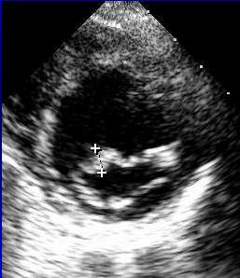
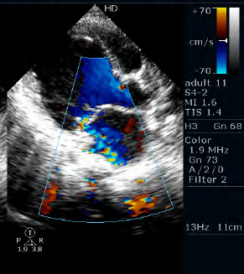

Slide 108
EXCESSIVE LEAFLET TIP MOTION
Normal RHD MVP

Slide 109
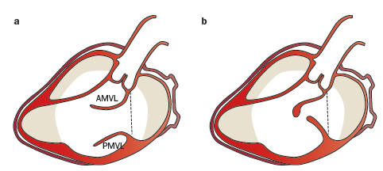
RESTRICTED MV LEAFLET MOTION
NORMAL RHD

Slide 110
VIJAYA’S ECHO CRITERIA

Slide 112
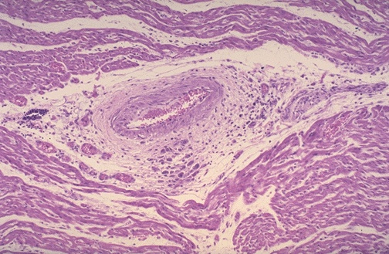
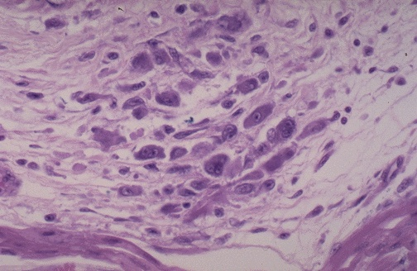
Endomyocardial biopsy
Aschoff nodules or histiocytic aggregates considered diagnostic of rheumatic myocarditis
Sensitivity 43% ,specificity of 100%
Myocyte degeneration usually without lymphocytic infiltration and frequently without Aschoff nodules.
Does not provide additional diagnostic information
Not recommended

Slide 113
RADIONUCLIDE IMAGING
GALLIUM-67 SCINTIGRAPHY
ANTIMYOSIN ANTIBODY IMAGING WITH INDIUM -111
Insufficient data to support the use of radionuclide scanning.
Gallium scintigraphy appears to be superior technique whereas the role of antimyosin appears to be equivocal

Slide 114
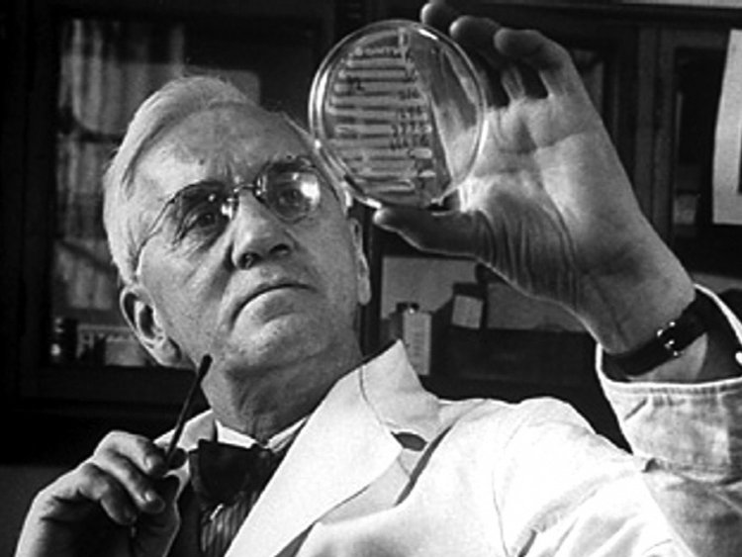
treatment

Slide 116
Treatment of rheumatic fever
General measures
pain relief
Bed rest
2 weeks for arthritis
4-6 weeks for carditis without failure
Until CCF resolves in patients with CCF

Slide 117
ANTIINFLAMMATORY THERAPY
1) Aspirin (once diagnosis is confirmed) with 100mg/kg for 2 weeks and then gradually tapered to 60 -80 mg/kg for another 4 wks
2) naproxen alternative 10-20mg/kg/day
3) steroids - Prednisone (1–2mg/kg-day, to a maximum of 80mg/day given once daily, or in divided doses) is usually the drug of choice in CHF

Slide 118
Indication for steroid
- not responding to salicylates
- worsening with CHF
After 2–3 weeks of therapy the dosage decreased
by 20–25% each week .
While reducing the steroid dosage, a period of overlap with aspirin is recommended to prevent rebound of disease activity

Slide 119
Chorea :
Reassurance & sedation
Nsaid & steroid have no role
Haloperidol 0.25-0.5 mg/kg/day
Carbamzepine(7-20 mg/kg/day) & valproate (15mg/kg/day) –refractory cases
Ivig & plasmapheresis-no benefit

Slide 120
Primordial prevention
Improvement in socio-economic status
(ii) Prevention of overcrowding
(iii) Improving nutritional status
(iv) Availability of prompt medical care
(v) Public education regarding
PRIMARY PREVENTION-
TREATMENT OF STREP PHARYNGITIS

Slide 121
Secondary prophylaxis
ANTIBIOTIC | MODE | DOSE
Benzathine benzyl penicillin | Single im every 3-4 weeks | >30kg – 12 lakh U <30 kg- 6 lakh U
Penicillin V | Oral | 250 mg bd
Sulfonamide ( sulfadiazine, sulfadoxine, sulfisoxazole) | oral | Adult >30kg- 1g od <30 kg – 500mg od
Erythromycin ethylsuccinate | Oral | 250mg bd
Notes:
SULFONAMIDE – SULFADIAZINE, SULFADOXINE AND SULFISOXAZOLE

Slide 122
Duration of secondary prophylaxis
Category of patienT | Duration
Without proven carditis | 5 years AFTER last attack or 18 yrs of age (longer)
with cardits (mild MR, healed carditis) | 10 yrs after last attack or 25 years of age (longer)
More severe valvular disease | Life-long
After valve surgery | Life long

Slide 123
Antistreptococcal vaccine
Components of GAS used in vaccine development
1)M- protein
2)GAS C5a peptidase, a major surface virulence factor
3) Fibronectin binding protein sfb1
4) Chimeric peptide J8 from the conserved region of the M- protein
M protein vaccines-less likely to succeed
1) Heterogeneous distribution of strains- varies from place to place and keeps changing even within a closed community in a short period.
2) On the basis of emm typing of M-protein more than 250 strains of GAS can cause infection and provide only strain-specific immunity.
3) GAS has a strong tendency for mutation

Slide 124
MCQ
Father of rheumatic heart disease
Sydenham
Duckett Jones
Charles Wells
Jean- Baptise Bouillaud

Slide 125
2. Correct the wrong statements
0.3 % of GAS pharyngitis in epidemic region develop ARF
Two-thirds of the cases of ARF have inapparent GAS infection
Rapid antigen test cannot differentiate between carrier and active infection
“Pentids” is oral Penicillin V

Slide 126
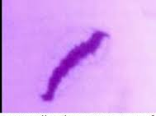
3. THIS IS??

Slide 127
4. Where is Mc Callum patch seen?
Atrial side of the mitral valve
Line of closure of mitral valve
Left atrium where MR jet hits
Left ventricle where AR jet hits

Slide 128
5. Not changes in 2015 AHA revision of Jones criteria is:
Monoarthralgia is included in minor criteria in high risk population
ESR cut off for low risk population is >30
Evidence of previous strep infection by culture / antigen or antibody testing/ history of scarlet fever in preceeding 14 days
Temperature more than 38 degree celcius is taken as fever in high risk population

